Slide 1
Web and mobile app development – csc3054/7054
1.2 Building up an Android application

Slide 2
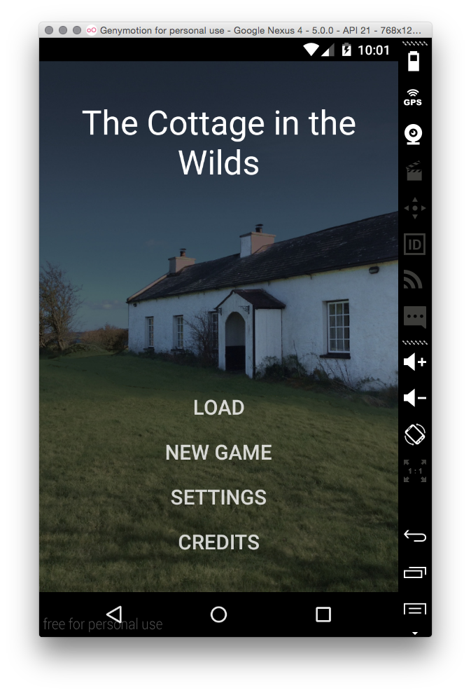
“Graphical text adventure” application
A videogame publisher intends to develop a novel piece of software to help promote its selling.
A set of games are used to resemble interactive books with static images of locations and events, supported by music and sound effects.

Slide 3
What we discussed in the last lecture?
Basic concepts of applications
Categorisation of mobile devices
Some examples
Android system architecture
Key components

Slide 4
Questions to be answered
What should one prepare before developing an Android application?
What kind of integrated development environment (IDE) is preferable?
How to create an Android application, e.g. “Hello World”?
How to execute an Android application on a virtual device or a real device?

Slide 5
Content outline
Development environment
Android SDK
Create an Android project
Summary
Next lecture
Further readings

Slide 6
Development environment
Android applications are developed in a host/target development environment:
To develop an application software on a host computer.
To execute the software on the target, e.g. emulator, mobile phone or tablet.
Applications can be tested and/or debugged on a real Android device or an emulator.
Why do we use an emulator rather than a real device sometimes?

Slide 7
Integrated development environments
Android Software Developer’s Kit (SDK) supports several different integrated development environments (IDEs):
IntelliJ IDEA (Android Studio)
Netbeans
Eclipse (Android Developer Tools – ADT)
Processing
More…

Slide 8
Why android studio instead of ADT bundle
Pros:
Smart design style.
Eclipse plugin will not be further developed.
IntelliJ is faster and lighter than Eclipse with more features.
Cons:
Still in early stage.
ADT – Android Developer Tools.

Slide 9
System requirements
Windows Vista, or Windows 7/8.
Mac OS X 10.8.5 or higher.
Linux:
GNOME or KDE desktop.
GNU C Library (glibc) 2.15 or later.
Ubuntu Linux, version 14.04 or later.

Slide 10
Content outline
Development environment
Android SDK
Create an Android project
Summary
Next lecture
Further readings

Slide 11
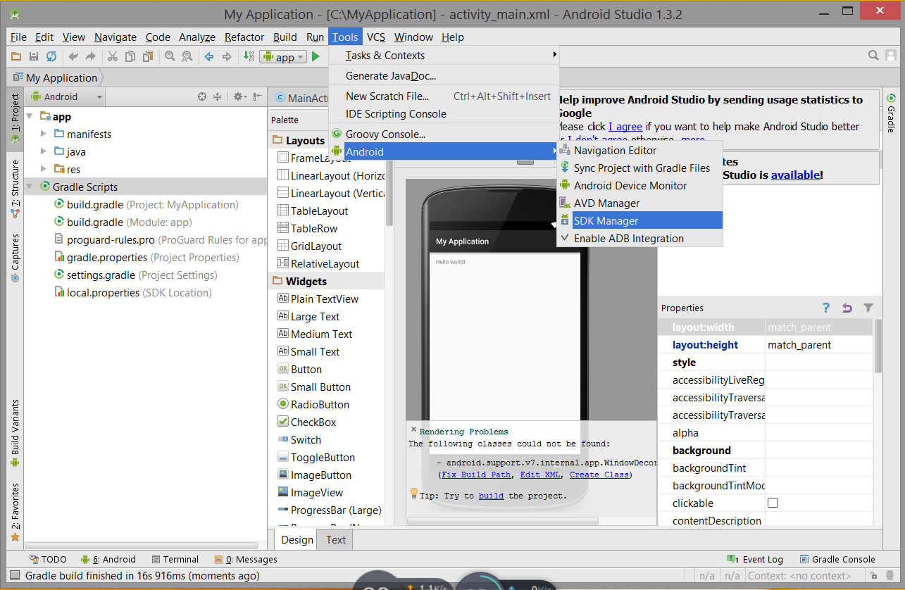
Android SDK
What does SDK provide?
It provides the Application Programming Interface (API) libraries and developer tools.

Slide 12
Android SDK
Android Studio Bundle includes everything that we need in order to develop an application: http://developer.android.com/sdk/index.html
Android Studio IDE.
Android Software Developer's Kit (SDK) tools.
Android 6.0 (Marshmallow) Platform.
Android 6.0 emulator system image with Google APIs.

Slide 13
To install SDK
Two ways to install SDK.
Download the Bundle to a local drive, e.g. android-studio-bundle-141.2456560-windows.exe.
Double-click the .exe file and follow the setup wizard to install Android Studio.
Once Android Studio has been installed, then we can double-click “Program Files\Android\Android Studio\bin\studio64” to launch the IDE in the next time.
Remember: to update Android SDK if necessary.

Slide 14
Content outline
Development environment
Android SDK
Create an Android project
Summary
Next lecture
Further readings

Slide 15
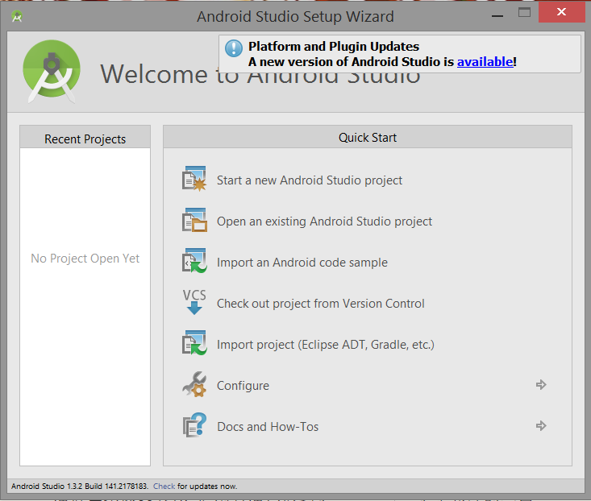
A new project

Slide 16
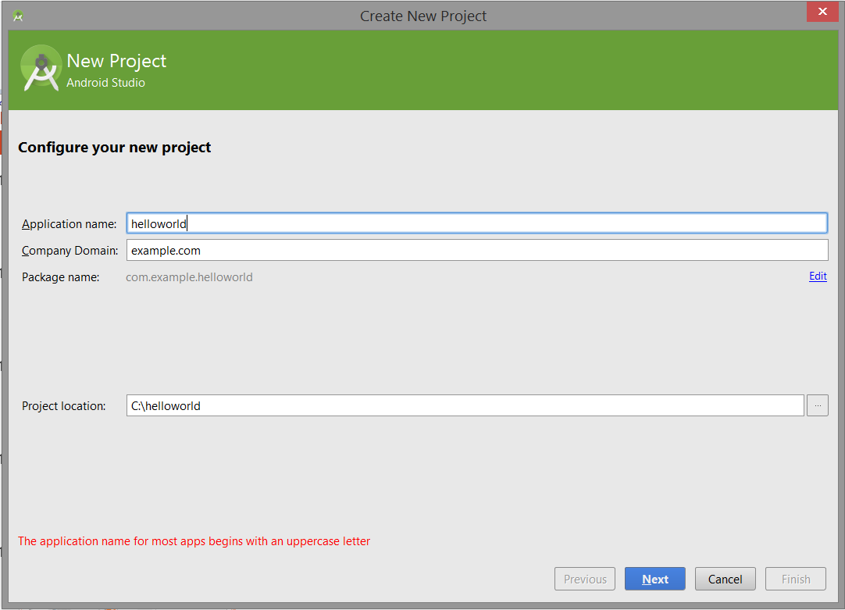
Configure new project

Slide 17
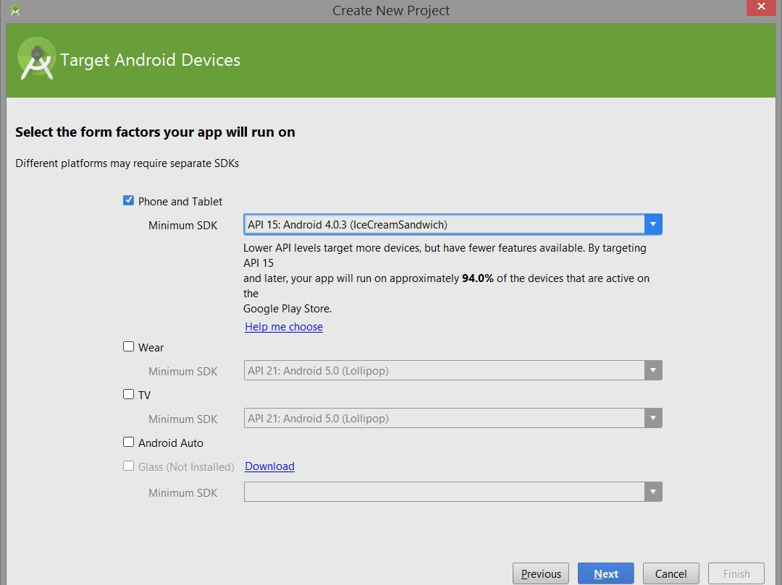
What platform to run your app

Slide 18
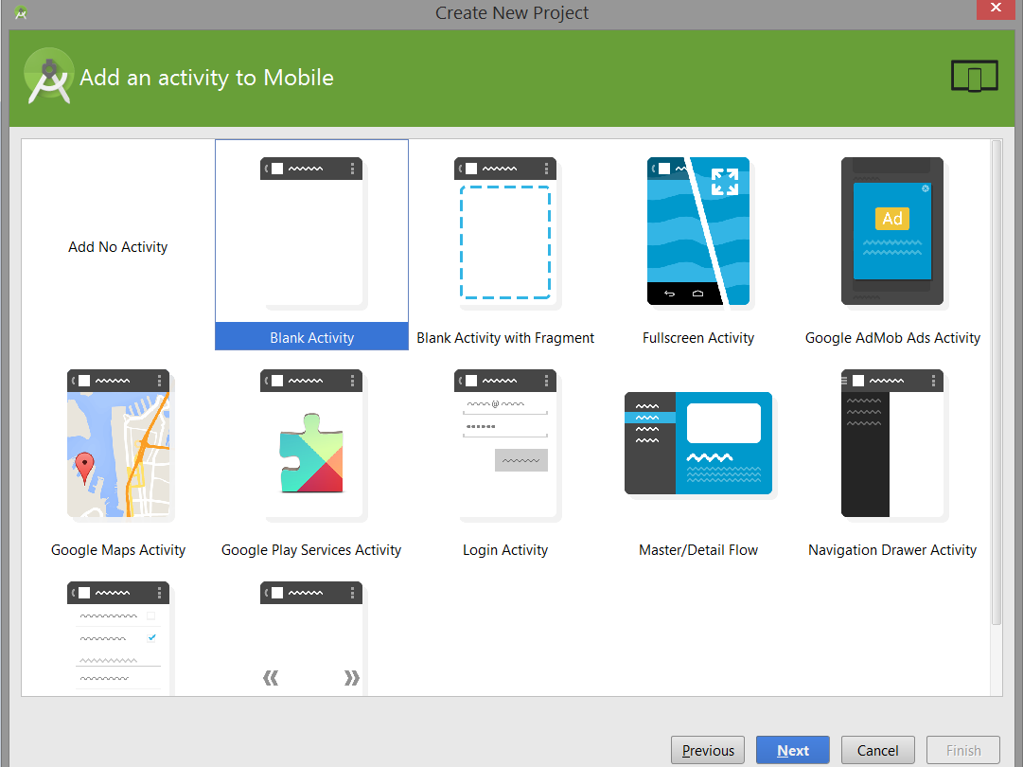
Activity option

Slide 19
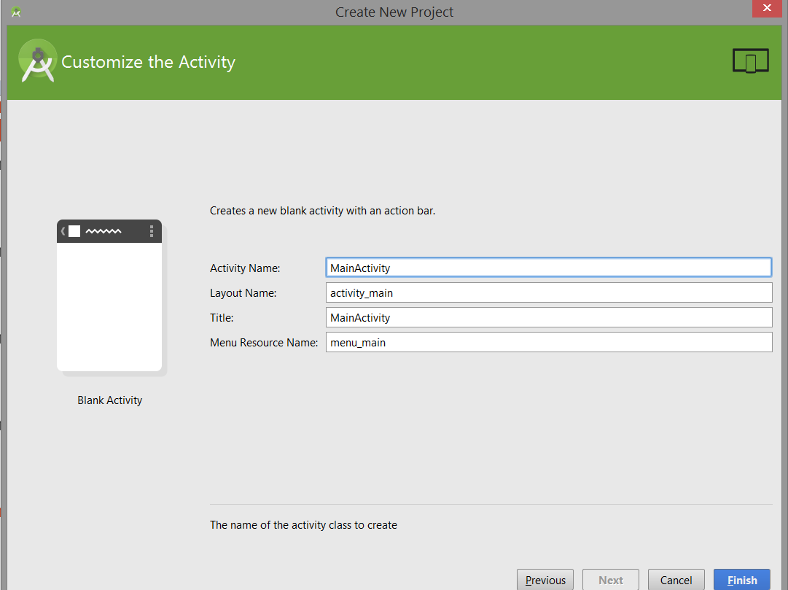
Activity name

Slide 20
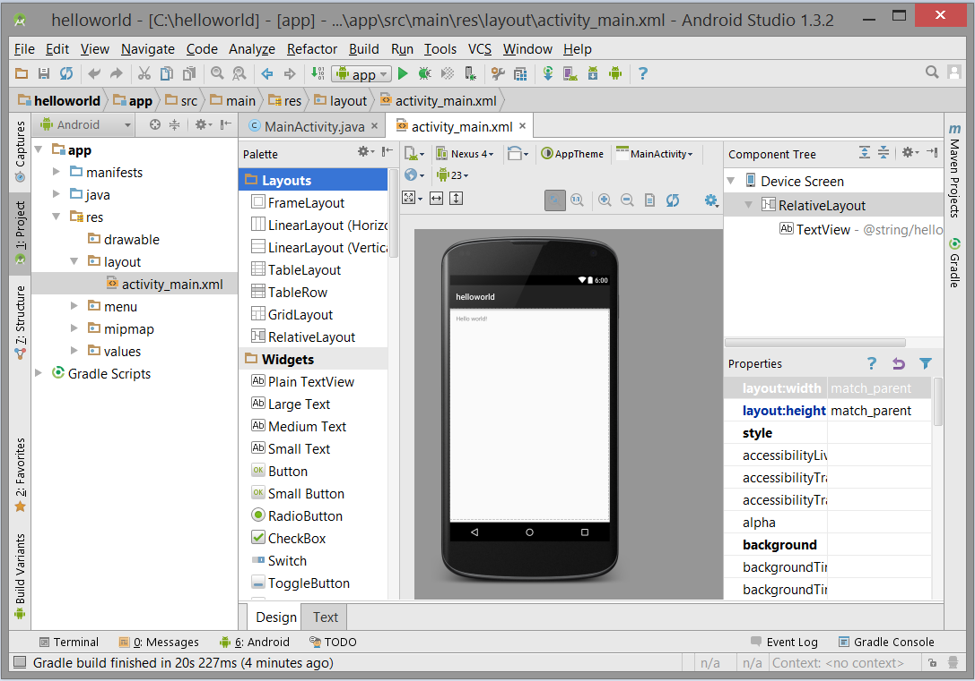
Ide Interface for “helloworld”

Slide 21
Running a project/application
On an emulator
On a real device
From a command line

Slide 22
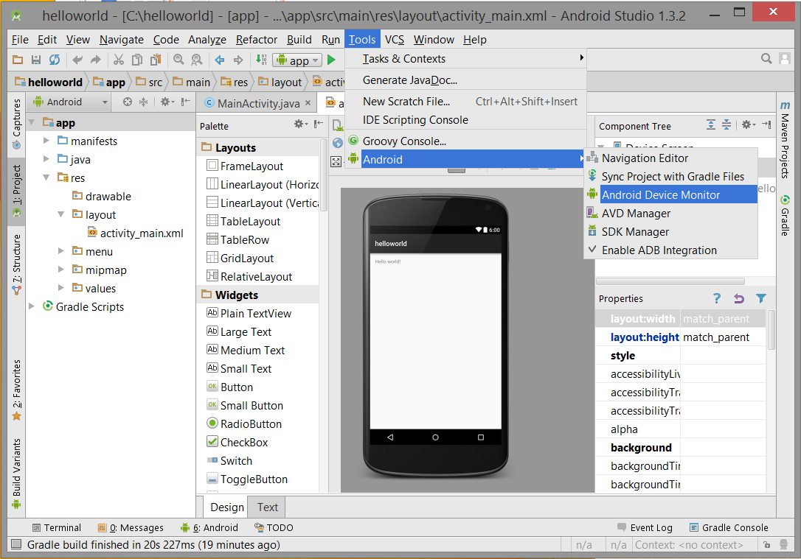
Launch android device monitor

Slide 23
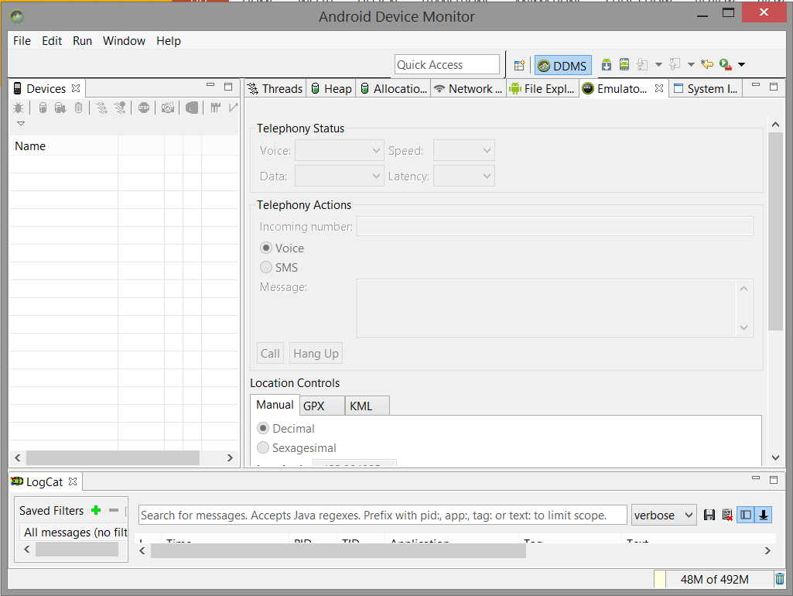
show android device monitor

Slide 24
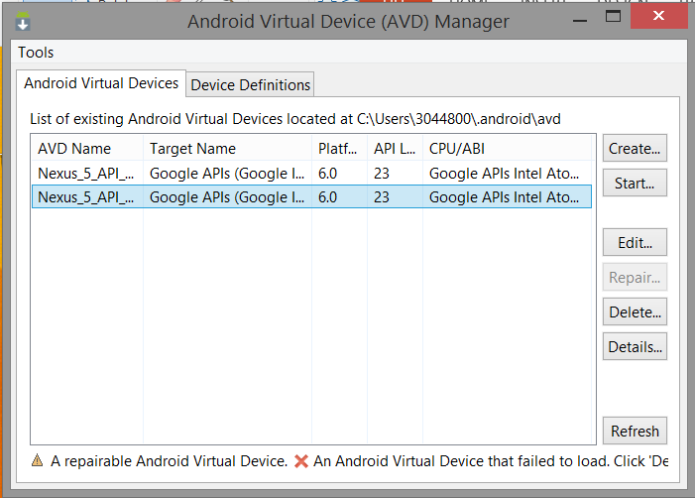
android virtual device

Slide 25
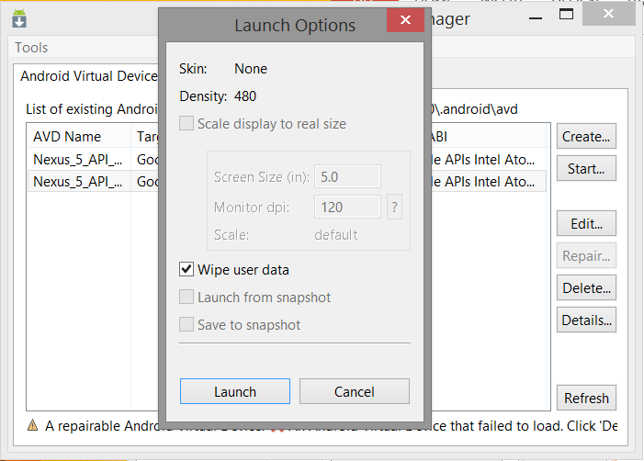
android virtual device

Slide 26
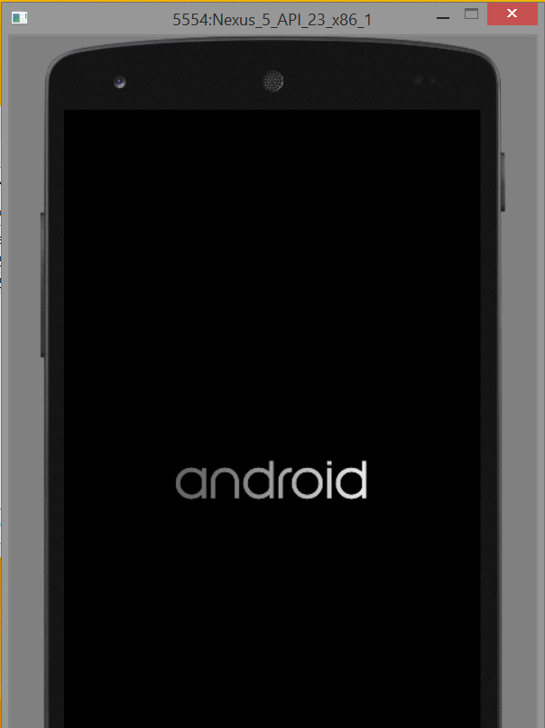
android virtual device

Slide 27
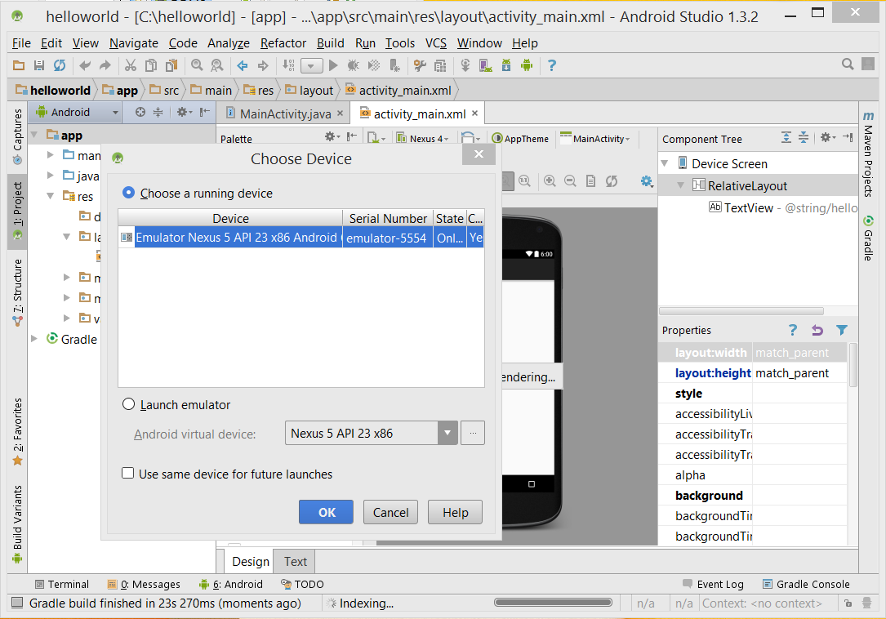
Run ‘app’

Slide 28
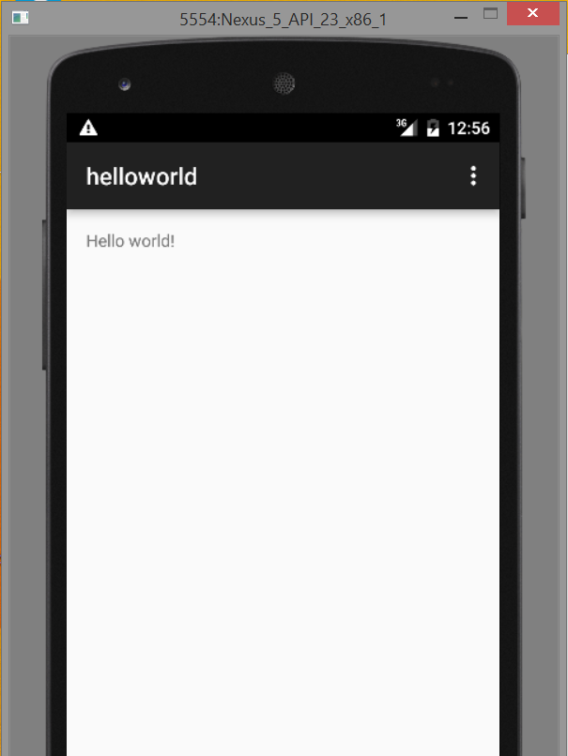
Show on the virtual device

Slide 29
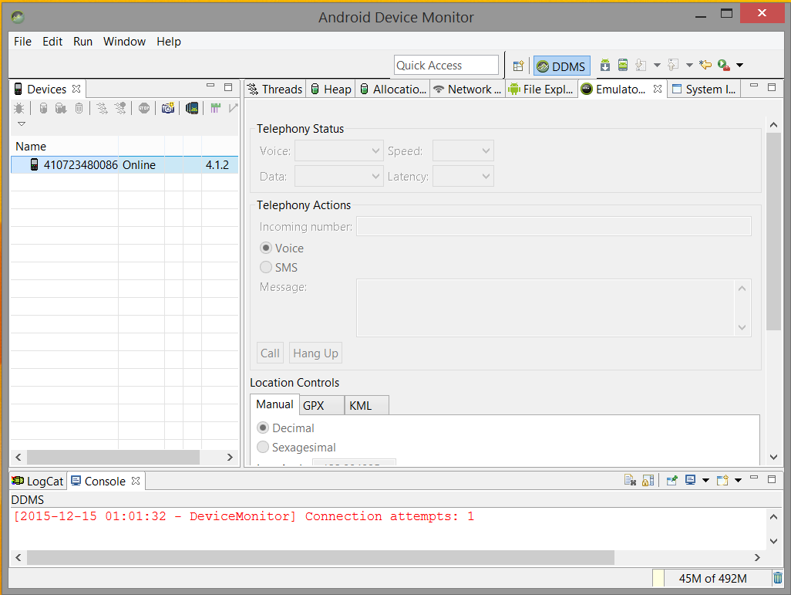
To run the application on a real device

Slide 30
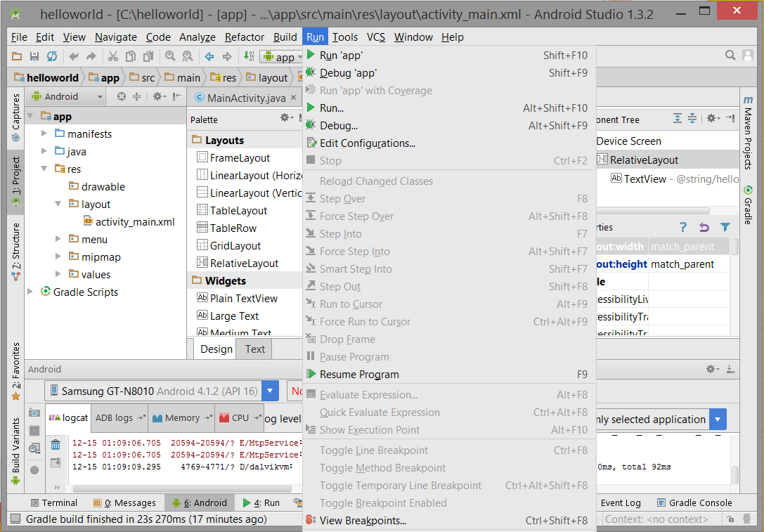
Run ‘app’

Slide 31
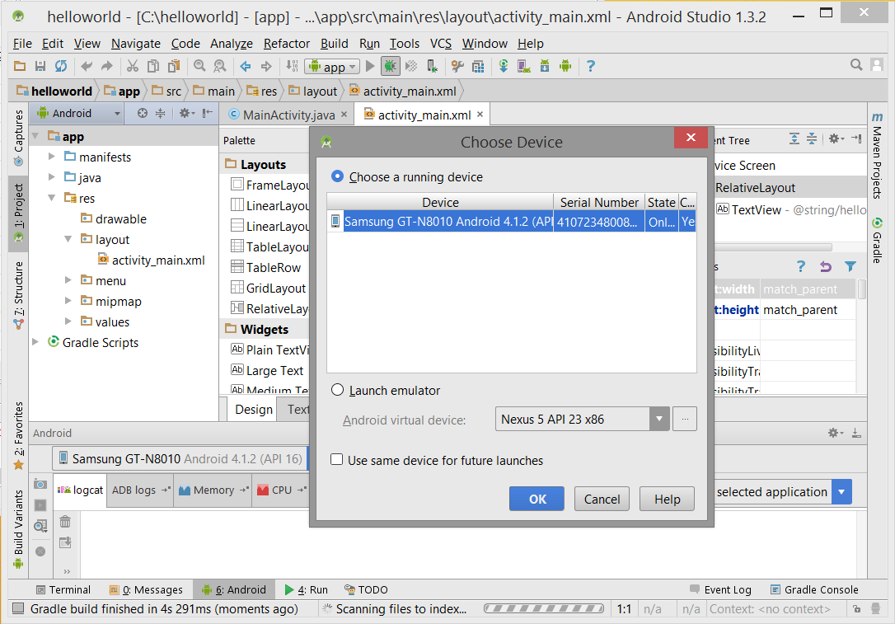
Done!

Slide 32
Content outline
Development environment
Android SDK
Create an Android project
Summary
Next lecture
Further readings

Slide 33
Summary
Established development environment for an application.
Created an Android project.
Run the Android project:
On the emulator
On real device

Slide 34
Content outline
Development environment
Android SDK
Create an Android project
Summary
Next lecture
Further readings

Slide 35
next lecture
To learn how to build user interface.

Slide 36
Content outline
Development environment
Android SDK
Create an Android project
Summary
Next lecture
Further readings

Slide 37
Further readings
http://developer.android.com/training/index.html
Android Application Development for Dummies, Donn Felker, Wiley Publishing, Inc., NJ, 2011.

